Slide 1
ABM Coursework Rumor Spreading Model
——by Group Halo

Slide 2
Contents
Background
Basic model
Modified model
Conclusion

Slide 3
Background

Slide 4
Background
Scale-free Network
The spread networks are "scale-free" in that they look the same at whatever scale you look. Such scale-free networks can be found in a surprisingly large range of real world situations, ranging from the connections between websites to the collaborations between actors.
There is a Preferential Attachment model in the networks section of the NetLogo models library. It generates a network where the probability of a new link being connected to a node is proportional to the number of links the node already has.

Slide 5
Background
SIR Model
Traditional virus spreading is usually based on SIR model: it divides the population into susceptible people(S), infected people(I) and recovered people(R). S means that an individual may be infected by infected people. Once he/she contacts the infected people(I), he/she will become infected. R indicates that after one or more cycles of infection, the individual will never be infected again.

Slide 6
Basic Model

Slide 7
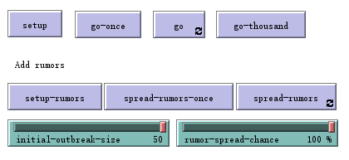
Basic Model
The basic rumor model is based on the traditional virus spreading model. We divide the basic model into two parts.
Network Generation
We set a “scale-free” network. We could clear all nodes or previous operations in the graphic with the “setup” button. In the first phase, if we want to simulate the network generation at one time step, we can use the “go-once” button. “go” button can let the graphic change automatically, which means every new individual will connect to his/her nearest nodes automatically without limitation. Besides, we set a “go-thousand” button to generate a network of 1000 susceptible agent to help us observe the model easily.
Spread Process
In the second phase, we can set rumors which are infected people with “setup-rumors”. The initial number can be changed with “initial-outbreak-size” slide. Moreover, we set a “rumor-spread-chance” slide which uses codes to generate a random number from 0 to 100, if this number is less than the number of this slide, then the susceptible person near the infected person will be infected.

Slide 8
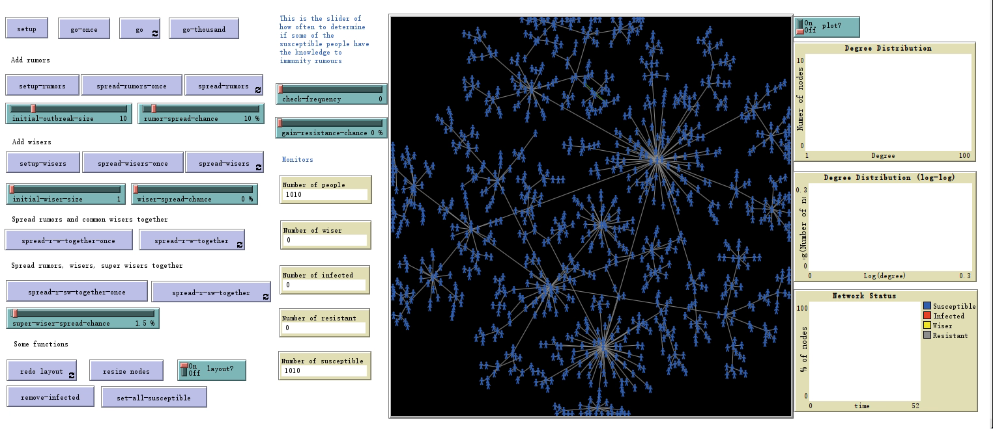
Basic model (S-I)
In the basic model, we first present the process of spreading susceptible people one by one by using “go-once” button. Then we add 1000 nodes with “go-thousand” button so that we can observe the network easily. After this process ends, we spread rumors with 10 “initial-outbreak-size” and 10% “rumor-spread-chance” then.

Slide 9
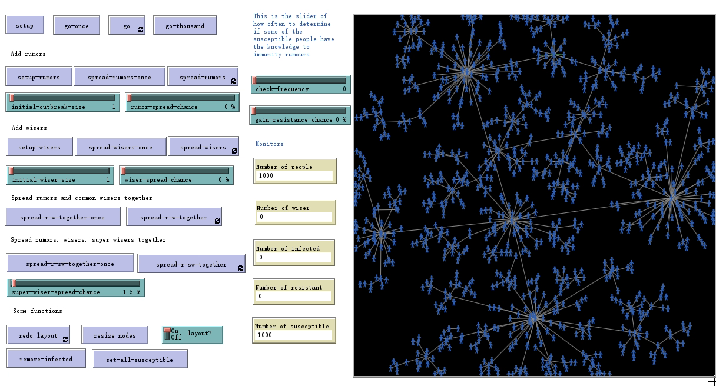
Basic model (S-I)
We can see that the speed of the rumor spreading is very fast without any counter measures. The main factor to affect this speed is the “rumor-spread-chance”. Although we set the initial number of infected people to “1”, the speed will still become faster and faster when we change the “rumor-speed-chance” from 0 to 100%.

Slide 10
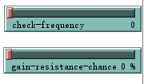
Basic Model (S-I-R)
In virus spreading the recovered agent could be transferred from infected agent, while in rumors spreading model, agent R is resistant agent who transfers from susceptible agent which means the agent learn by his/herself to get the ability of avoiding the rumors.
Therefore, we set two slides: “check frequency” and “gain-resistance-chance”. The first slide stands for a certain time step and the second slide stands for a probability.
We also use codes to generate a random number from 0 to 100, if this number is less than the number of the second slide, then the susceptible people will be resistant. This function means that some susceptible people will become resistant themselves after every few seconds during the process of rumor spreading. These resistant people will never be infected.

Slide 11
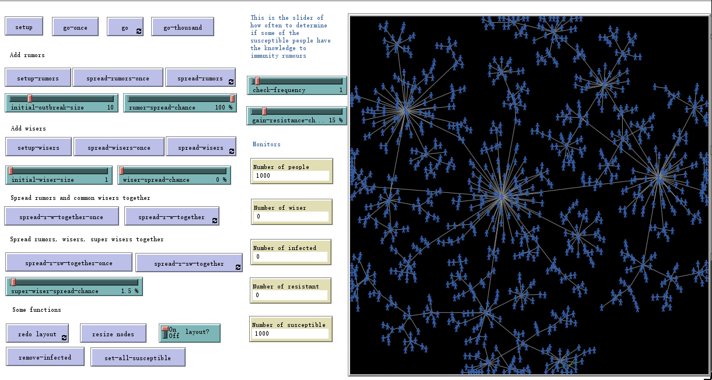
Basic Model (S-I-R)
We can see that resistant people may have a great effect on spread process. Even though we set “rumor-spread-chance” to 100% and “gain-resistant-chance” to 15%, the infected still can not dominate all nodes.
In order to further study the counter part of rumor spreading, we decide to involve clarifiers and super clarifiers in the experiment.

Slide 12
Modified model

Slide 13
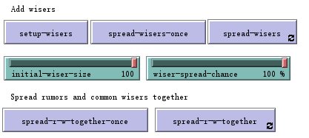
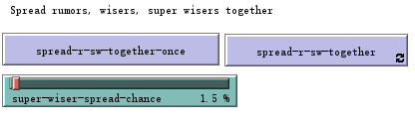
Modified Model
Based on traditional model, we added two more kinds of agents: clarifiers (W) and super clarifiers (SW). Clarifiers represent those who can tell and think about things rationally without being affected by other people. They can make infected people become resistant with a certain probability. Super clarifiers can make people who are not super clarifiers become super clarifiers directly with 100% probability.

Slide 14
Modified Model
In next phase, we add clarifiers to the model and observe the result. We use “setup-wiser” to set the initial number of clarifiers as before, the number depends on the slide “initial-wiser-size” which can be changed from 0 to 100.
We also use codes to generate a random number from 0-100, if this number is less than the number of the slide “wiser-spread-chance”, then a certain infected person near the clarifier will be resistant. Besides, we set “spread-r-w-together” button to let rumor and clarifier spread together.

Slide 15
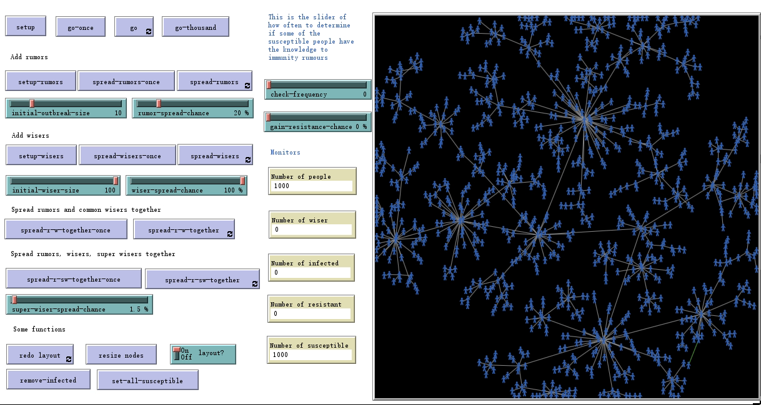
Modified Model (S-I-W)
When we first spread rumors and then spread clarifiers, we can find even though we set the number of clarifiers to the maximum, they can only play a finite role in preventing rumors from spreading because they can only affect people near them. Moreover, there are few resistant people.
We guess the position of a clarifier in a cluster may also make a big difference, which means the center of a certain cluster may play an important role.

Slide 16
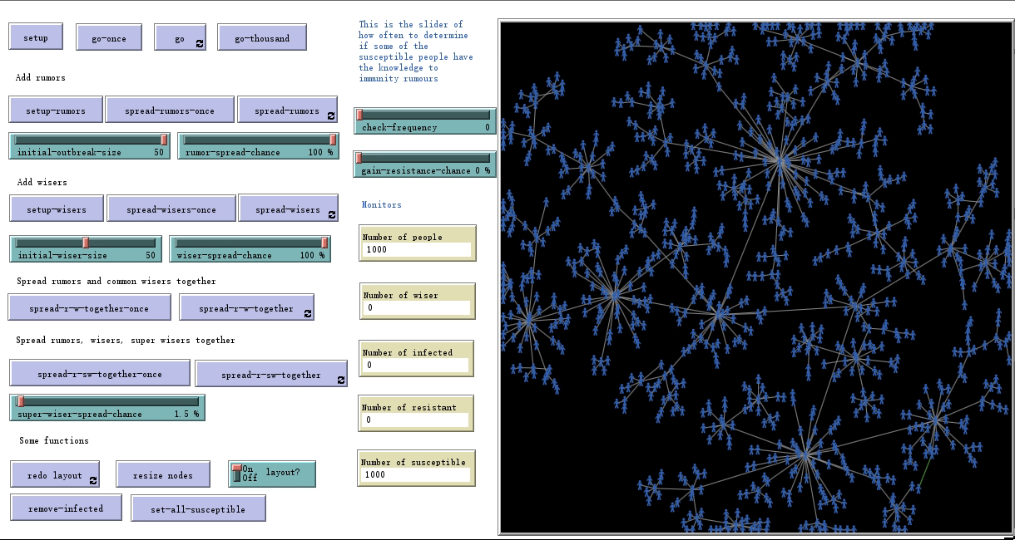
Modified Model (S-I-W)
Therefore, we change our strategy. We decide to spread clarifiers at first and then spread rumors after setting the same initial number of rumors and clarifiers.
As expected, the infected can not play a dominant role this time because most centers of clusters are clarifiers or near clarifiers.
Then we increase the number of clarifiers to maximum, the infected become fewer.

Slide 17
Modified Model (S-I-SW)
The last phase is to add super clarifiers to the model and observe the result. We use “setup-wisers” to set initial clarifiers as before, the spread probability of super clarifiers depends on the slide “super-wiser-spread-chance” from 0 to 100%.
We also use codes to generate a random number from 0-100, if this number is less than the number of this slide, then a certain person who is not a super clarifier near the clarifier will become a super clarifier directly. Besides, we set “spread-r-sw-together” button to let rumor and super clarifier spread together.

Slide 18
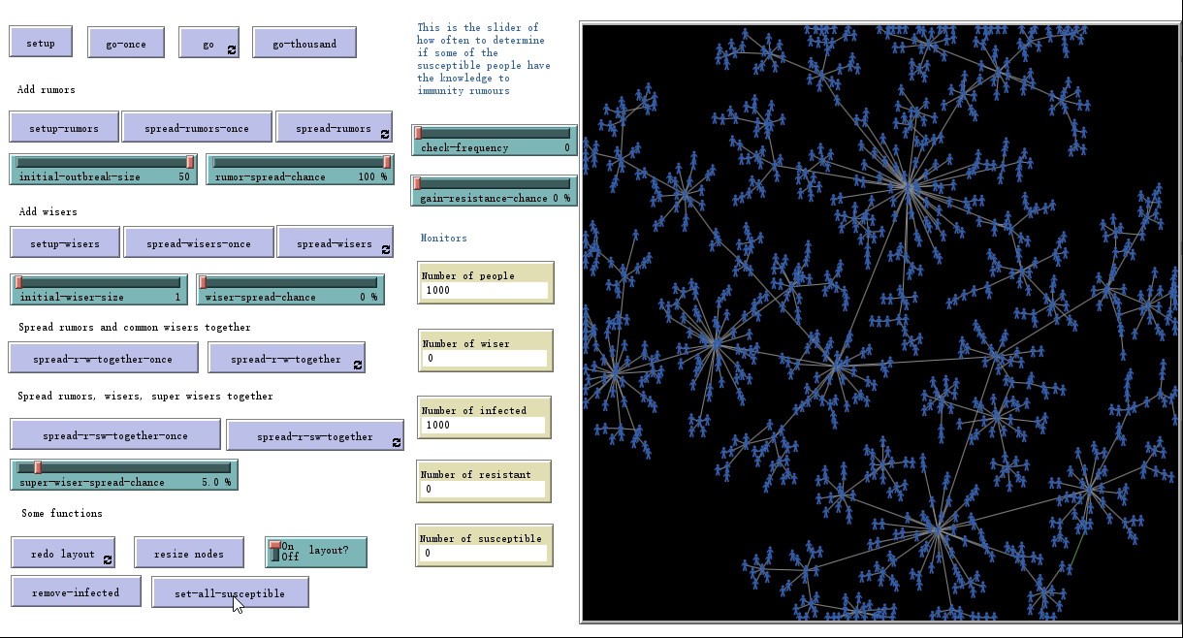
Modified Model (S-I-SW)
We set all the parameters of rumors to the maximum, the number of super clarifiers to “1” and “super-wiser-spread-chance” to only 5%. And we use the “spread-r-sw-together” button to run the program. At first, the rumors take the dominant position, as time goes by, super clarifiers are becoming more and more dominant. Finally, all the nodes become super clarifiers.

Slide 19
Conclusion

Slide 20
Conclusion
After some experiments with the rumor spreading model, we find 2 main factors that may greatly affect rumor spreading:
1. Consciousness of self-recovery. We can see that the results are different between the experiment with resistant people and experiment without resistant people. Therefore, if more individuals can realize bad effects of rumors themselves, the rumor will not spread fast any longer.
2. Influence of a clarifier. Both the center of a certain cluster and the power of a clarifier are manifestations of the influence. If a person is in the center of a small network, people around him/her will be influenced easily no matter what he/she says is good or bad. Moreover, if a person have a great power to influence others, what he/she says will also be spread fast no matter it is good or bad.

Slide 21
THANKS FOR WATCHING

